Slide 1
Real Estate Pricing Prediction Analysis

Slide 2
Introduction
Real estate price prediction is the process of using data and machine learning algorithms to predict the future value of a property. The goal is to provide an accurate estimate of a property's value, which can be useful for various stakeholders , Homebuyers, Real estate agents, Sellers.
By using machine learning algorithms and hybrid models, it is possible to improve the accuracy of price predictions and provide valuable insights to stakeholders in the real estate industry.

Slide 3
Setting Up the Environment
Mounting Google Drive in Google Colab.
Importing necessary libraries (Pandas, NumPy, Matplotlib, Seaborn, Plotly, etc.)
Loading the dataset which is provided .
Splitting the dataset into training and testing sets.
Check Shape and size of the training and testing datasets

Slide 4
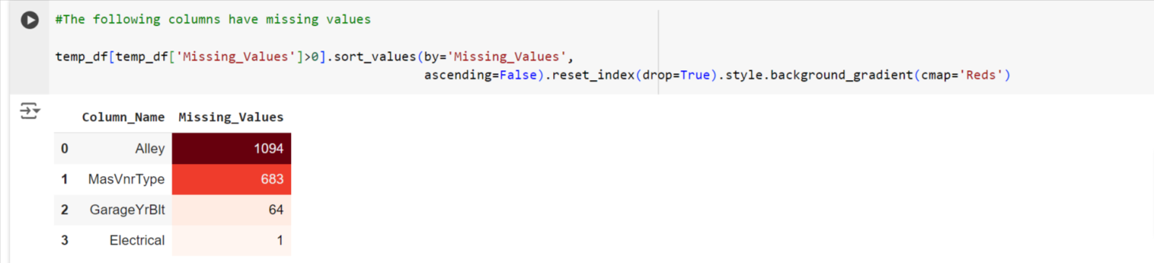
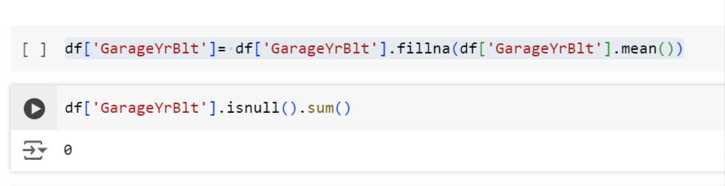
Data Cleaning
Handling missing values in the training set
Dropping unnecessary columns (e.g., 'Alley')
Filling missing values with appropriate strategies (e.g., mode for 'Electrical', mean for 'GarageYrBlt')

Slide 5
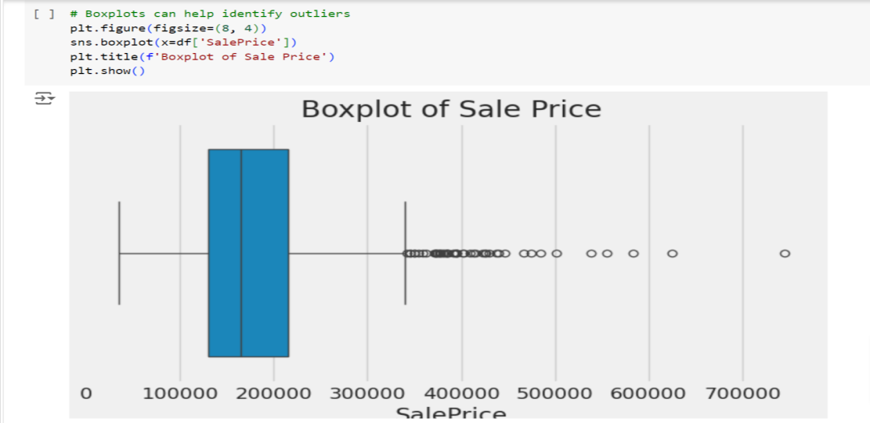
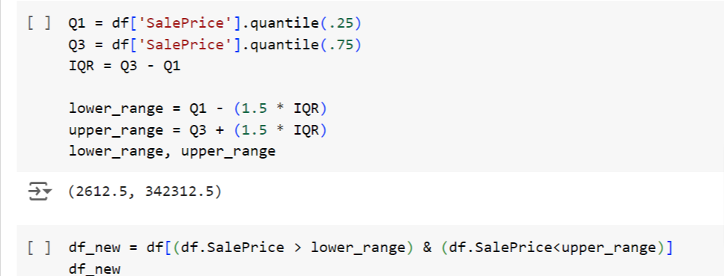
Univariate Analysis
Boxplot of 'SalePrice' to identify outliers
Removing outliers based on IQR

Slide 6
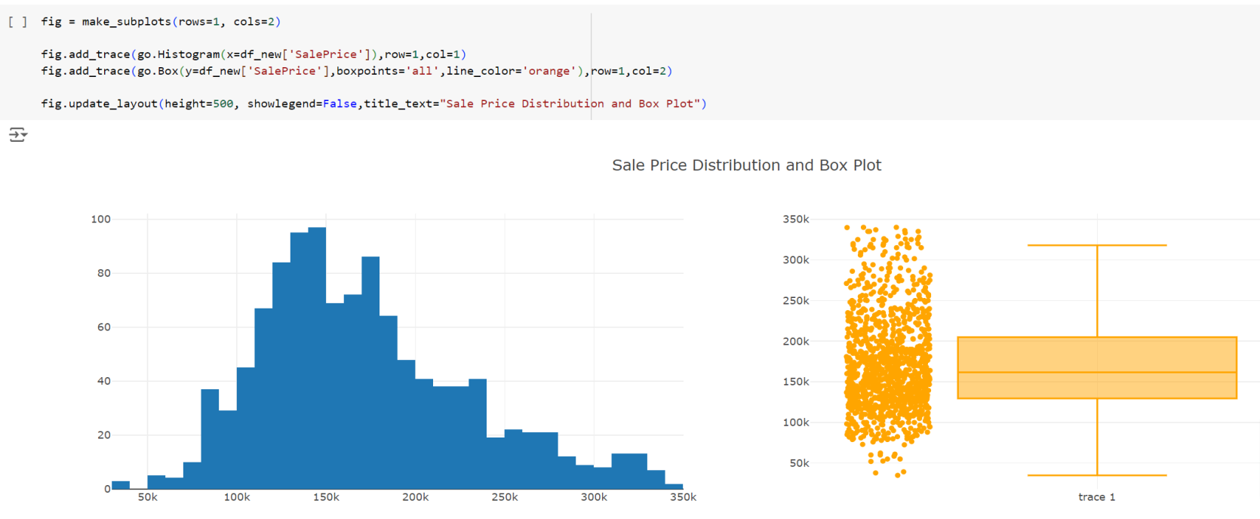
Checking sale distribution
Graph outcome :
This plot shows the distribution of sale prices and a box plot of the same data.
The box plot gives us a summary of the data, showing the median, quartiles, and outliers.
The median sale price is around 180k, and the majority of houses were sold between 130k and 220k.
There are some outliers with sale prices above 300k.

Slide 7
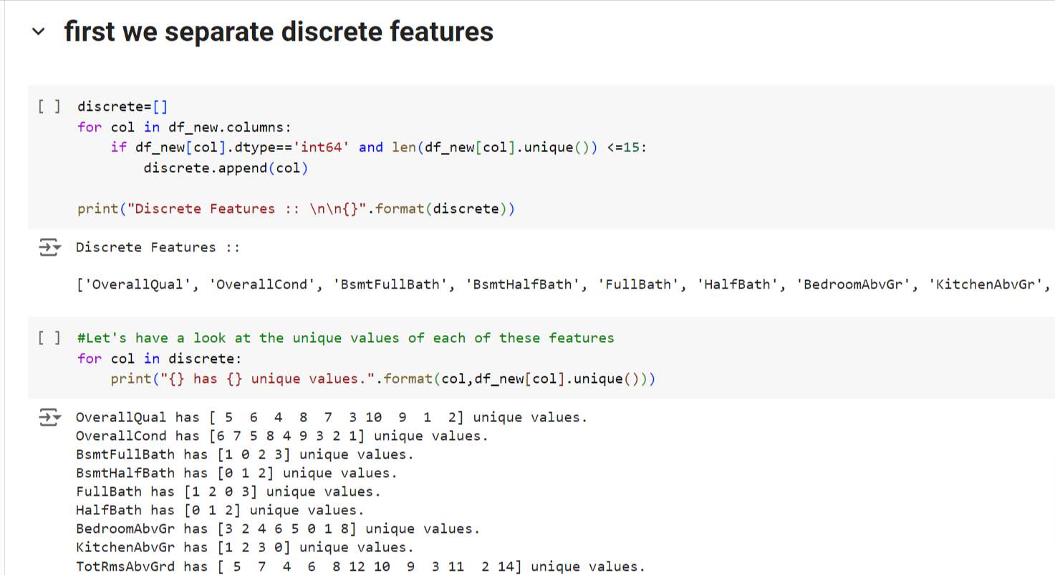
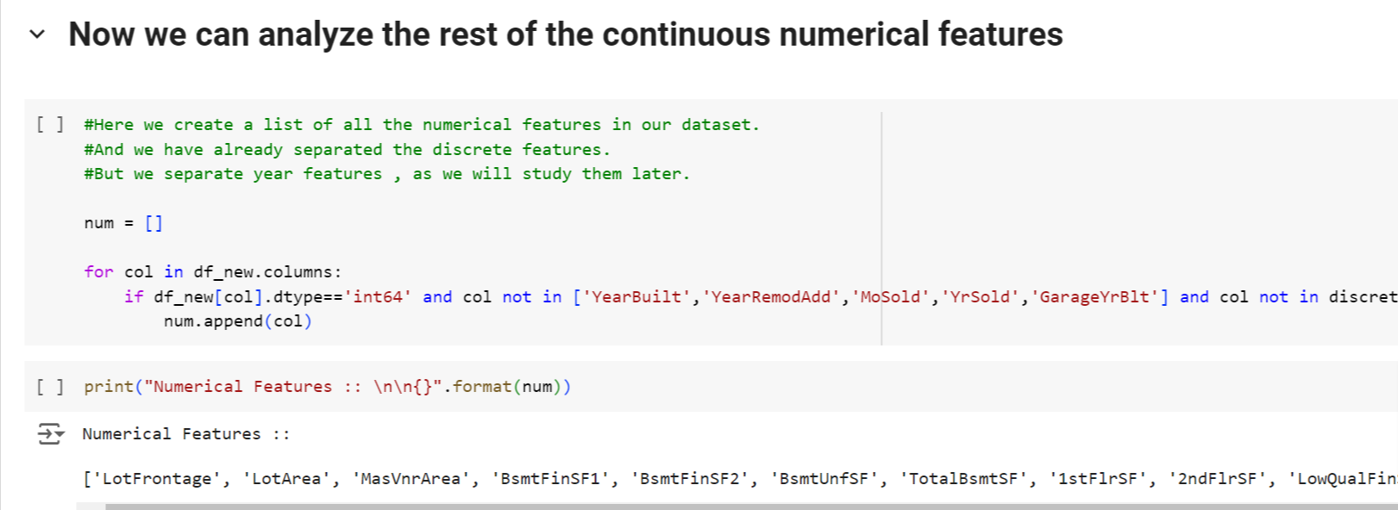
Numerical Analysis
Continuous Numerical Analysis

Slide 8
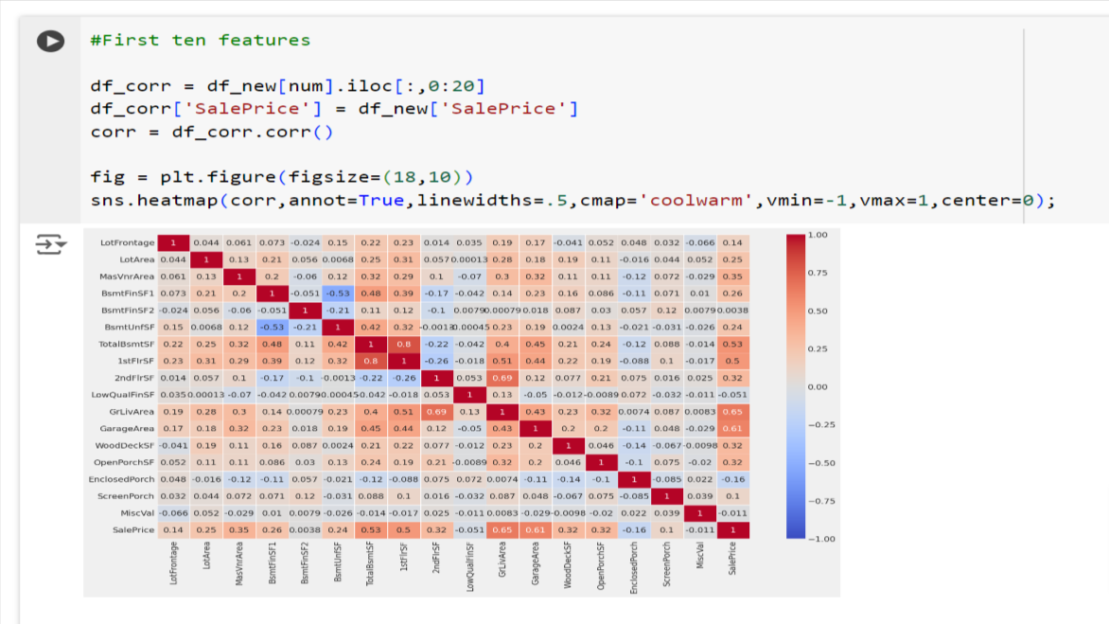
Multivariate Analysis
Correlation heatmap of numerical features with 'SalePrice‘
Outcome:
here Ground living Area has a positive correlation of 0.65 with Sale Price.
Garage Area is having a positive correlation of 0.61.
TotBsmtSF feature has a 0.53 correlation with SalePrice.

Slide 9
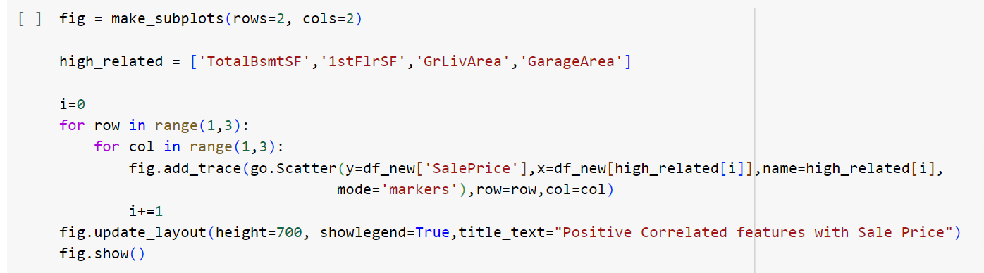
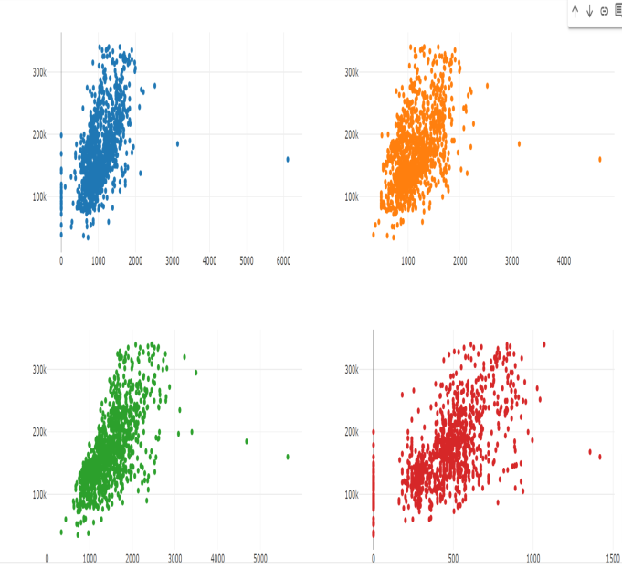
Scatter plots of top correlated features with 'SalePrice‘
Outcome: We can see that as the features on xaxis increases , Sale Price also increases.This shows the positive correlation between them.

Slide 10
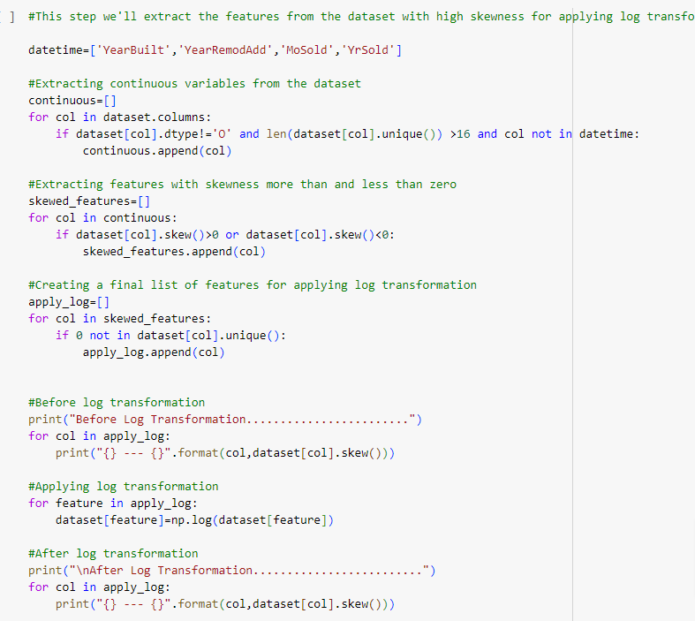
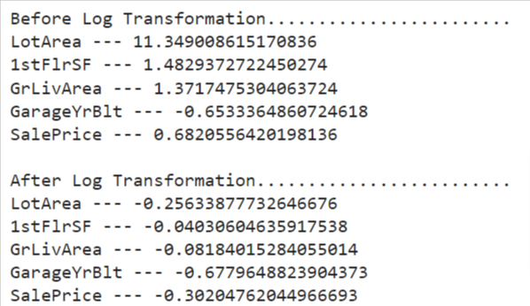
Applying log transformation to highly skewed features.
Feature Engineering
High Skewed feature
Output

Slide 11
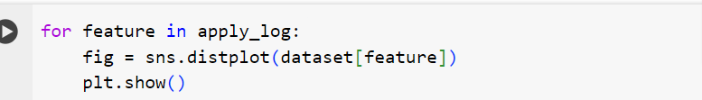
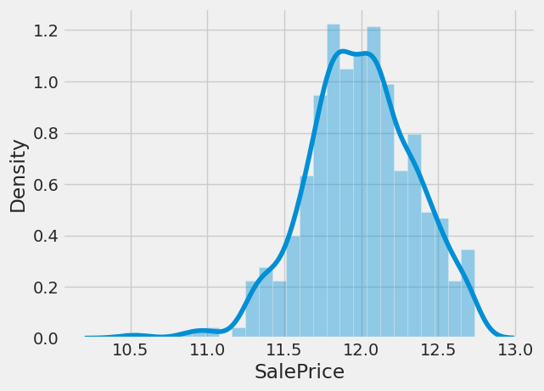
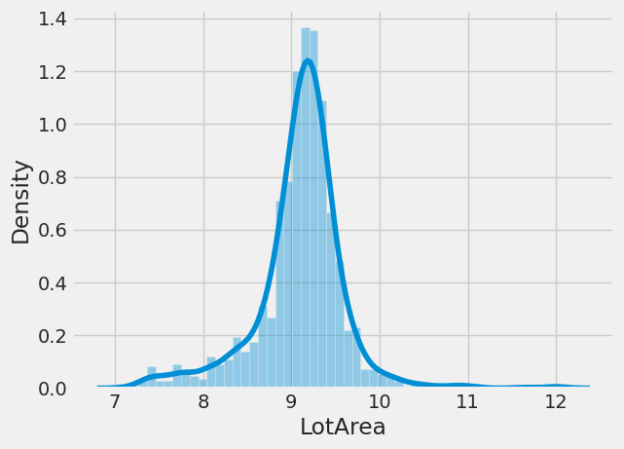
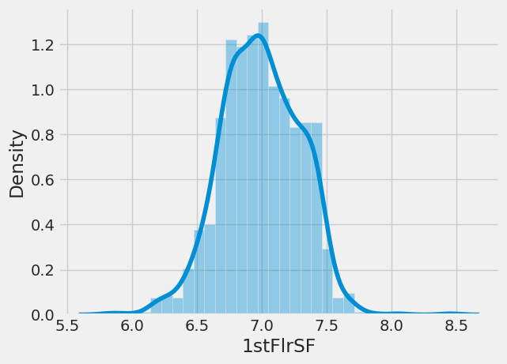
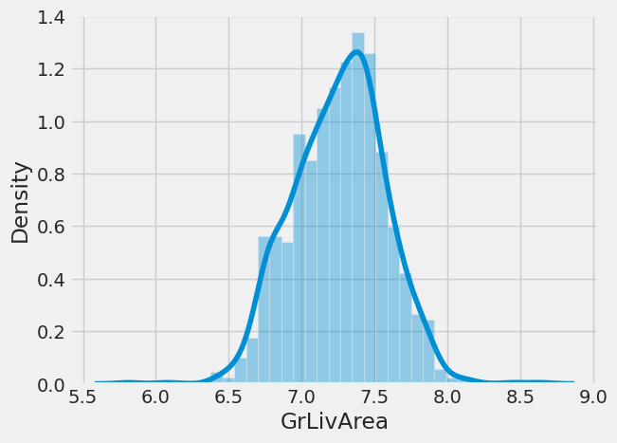
Dist plot to show skewness

Slide 12
Outcome of dist plot :
Here are some observations about the histograms:
The SalePrice distribution has a clear peak around $120,000. This suggests that there are a lot of houses in this price range.
The LotArea distribution has a peak around 9,000 square feet. This suggests that there are a lot of houses with this lot area.
The 1stFlrSF distribution has a peak around 7,000 square feet. This suggests that there are a lot of houses with this first floor square footage.
The GrLivArea distribution has a peak around 7,500 square feet. This suggests that there are a lot of houses with this above ground living area square footage.

Slide 13
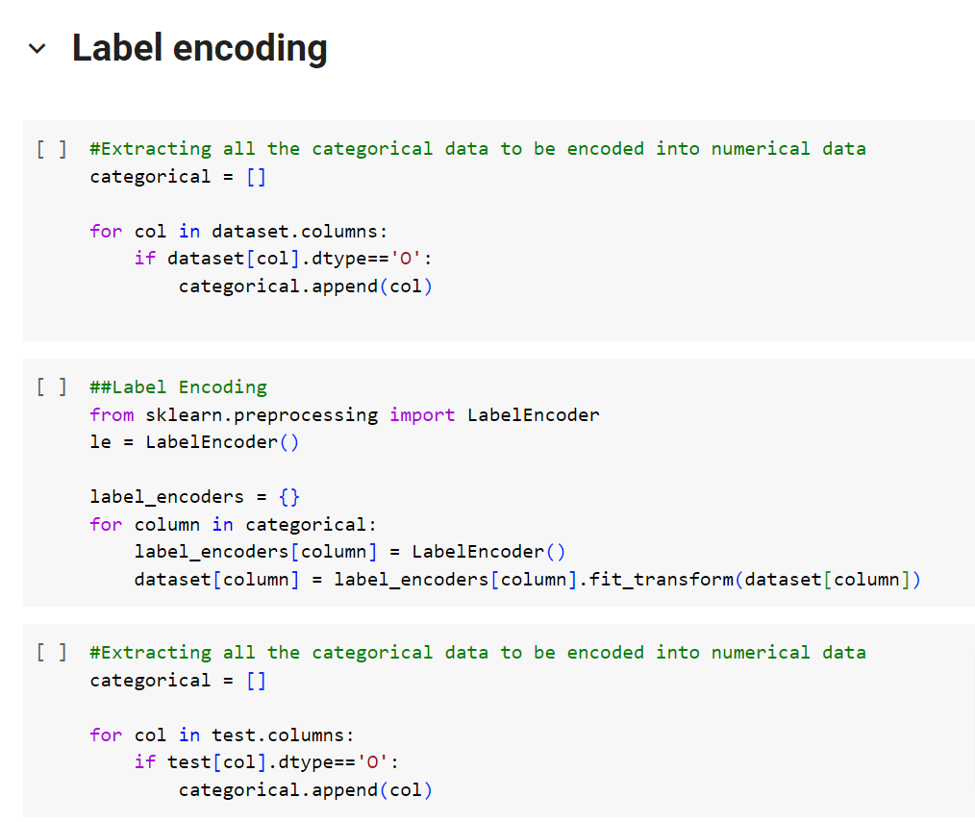
Label encoding for categorical features
Label encoding

Slide 14
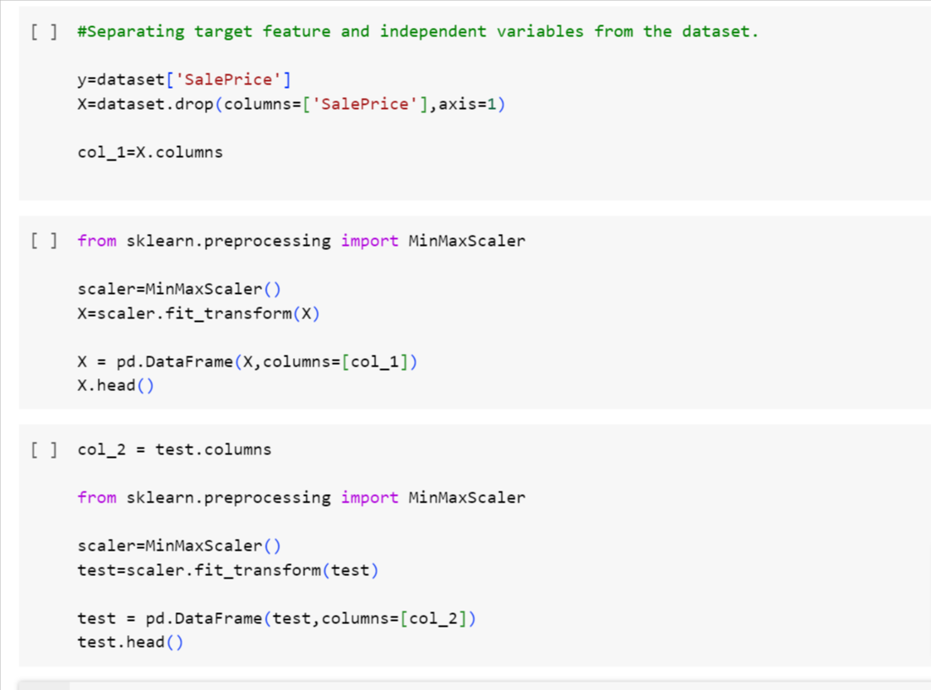
Feature Scaling

Slide 15
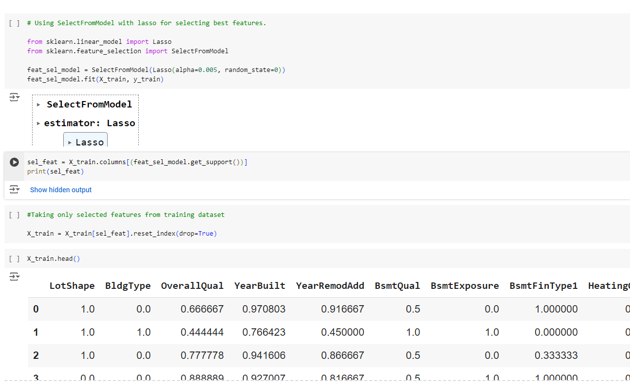
Feature Selection
Using SelectFromModel with Lasso for feature selection

Slide 16
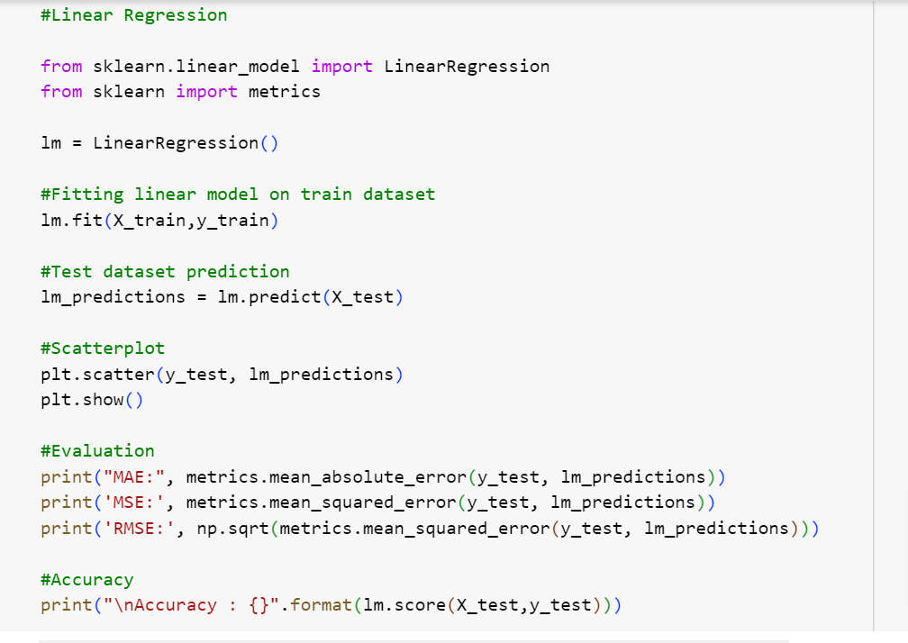
Model Building
Fitting a linear regression model
Scatterplot of actual vs. predicted prices
Model evaluation metrics (MAE, MSE, RMSE)

Slide 17
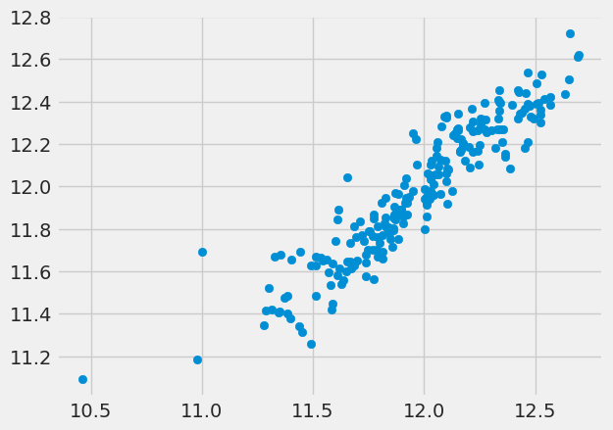
Model Performance
Final model accuracy

Slide 18
Outcome:
This scatter plot shows a strong positive correlation between two variables. As the value of one variable increases, the value of the other variable also increases. The points are clustered closely together, indicating a strong linear relationship.
MAE: 0.09679495980883399
MSE: 0.01776372124348488
RMSE: 0.1332806109060312
Accuracy : 0.8618869887417928

Slide 19
Summary of Findings
Developed a machine learning model to predict property prices based on various features
Explored and cleaned the dataset, handling missing values and outliers
Applied feature engineering techniques, including log transformation and label encoding
Selected the most relevant features using Lasso regression
Trained and evaluated a linear regression model, achieving an accuracy of [0.8618869887417928]

Slide 20
Market Trends and Historical Pricing
Historical Pricing Analysis:
Analyzed the historical pricing data of the housing market
Identified trends and patterns in the data, including:
Seasonal fluctuations in prices
Long-term appreciation in property values
Impact of economic indicators on housing prices
Market Trends:
Identified key market trends, including:
Shift towards urbanization and increased demand for city-center properties
Growing popularity of sustainable and eco-friendly homes
Increased investment in real estate technology and innovation

Slide 21
Customer Preferences and Amenities
Key Findings:
Location is the most important factor for homebuyers, followed by size and price
Amenities such as parking, outdoor space, and proximity to public transportation are highly valued
Energy efficiency and sustainability are becoming increasingly important to homebuyers
Amenities Analysis:
Analyzed the availability and impact of various amenities on property prices
Identified the most valuable amenities, including:
Parking
Outdoor space
Proximity to public transportation
Energy efficiency and sustainability features

Slide 22


